Slide 1



Young Scientists in an Age of Knowledge Neocolonialism
Peter Murray-Rust^{1,2}
ResearchAI Summit, Delhi IN, 2025-06-10
Let’s build a modern Open knowledgebase
which we, not megacorporations, control
[1]University of Cambridge [2]semanticClimate.org peter.murray.rust@googlemail.com

Slide 2
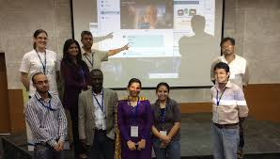
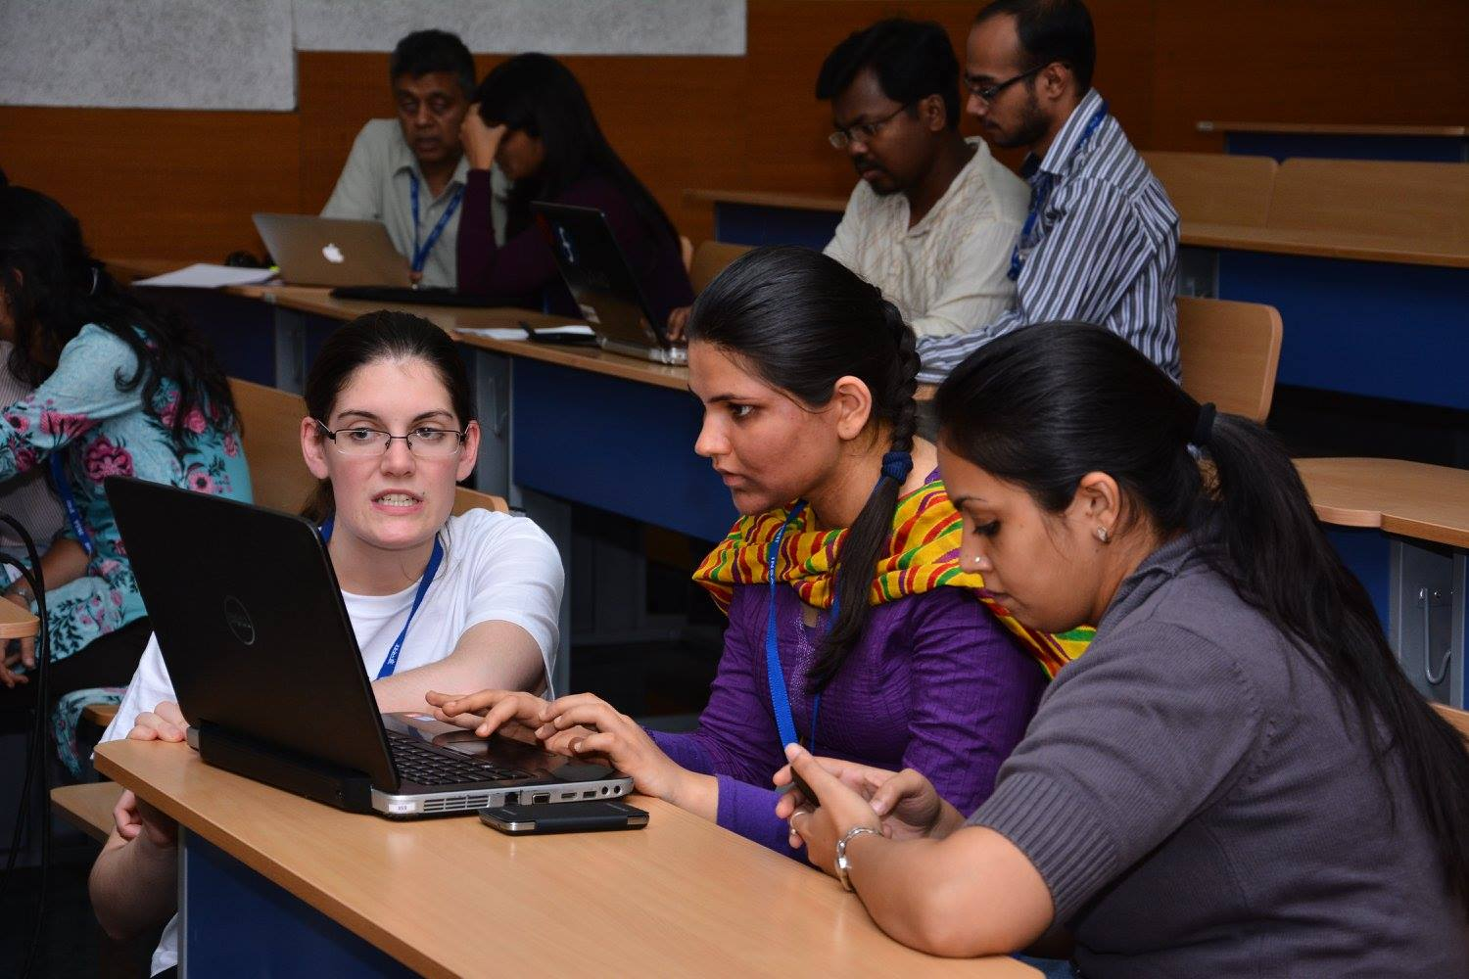
Puneet
Kishoor
JNU/Delhi 2014
Jenny Molloy
Peter Murray-Rust, online
Gita Yadav
GY
PK
JM
https://scidatacon2014.org/tdm-workshop
And the actual hack (Jenny Molloy) https://github.com/ContentMine/SciDataCon2014/

Slide 3
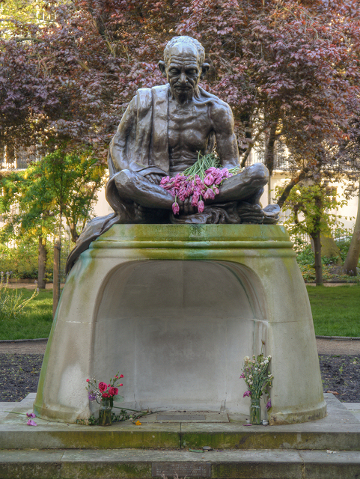
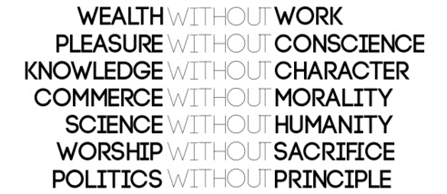
Gandhi’s Values
NO:
Mahatma Gandhi, 1925
London, UK
What are our values for scientific knowledge and its dissemination?
NO:
PEOPLE WITHOUT ACCESS AI. WITHOUT THINKING

Slide 4
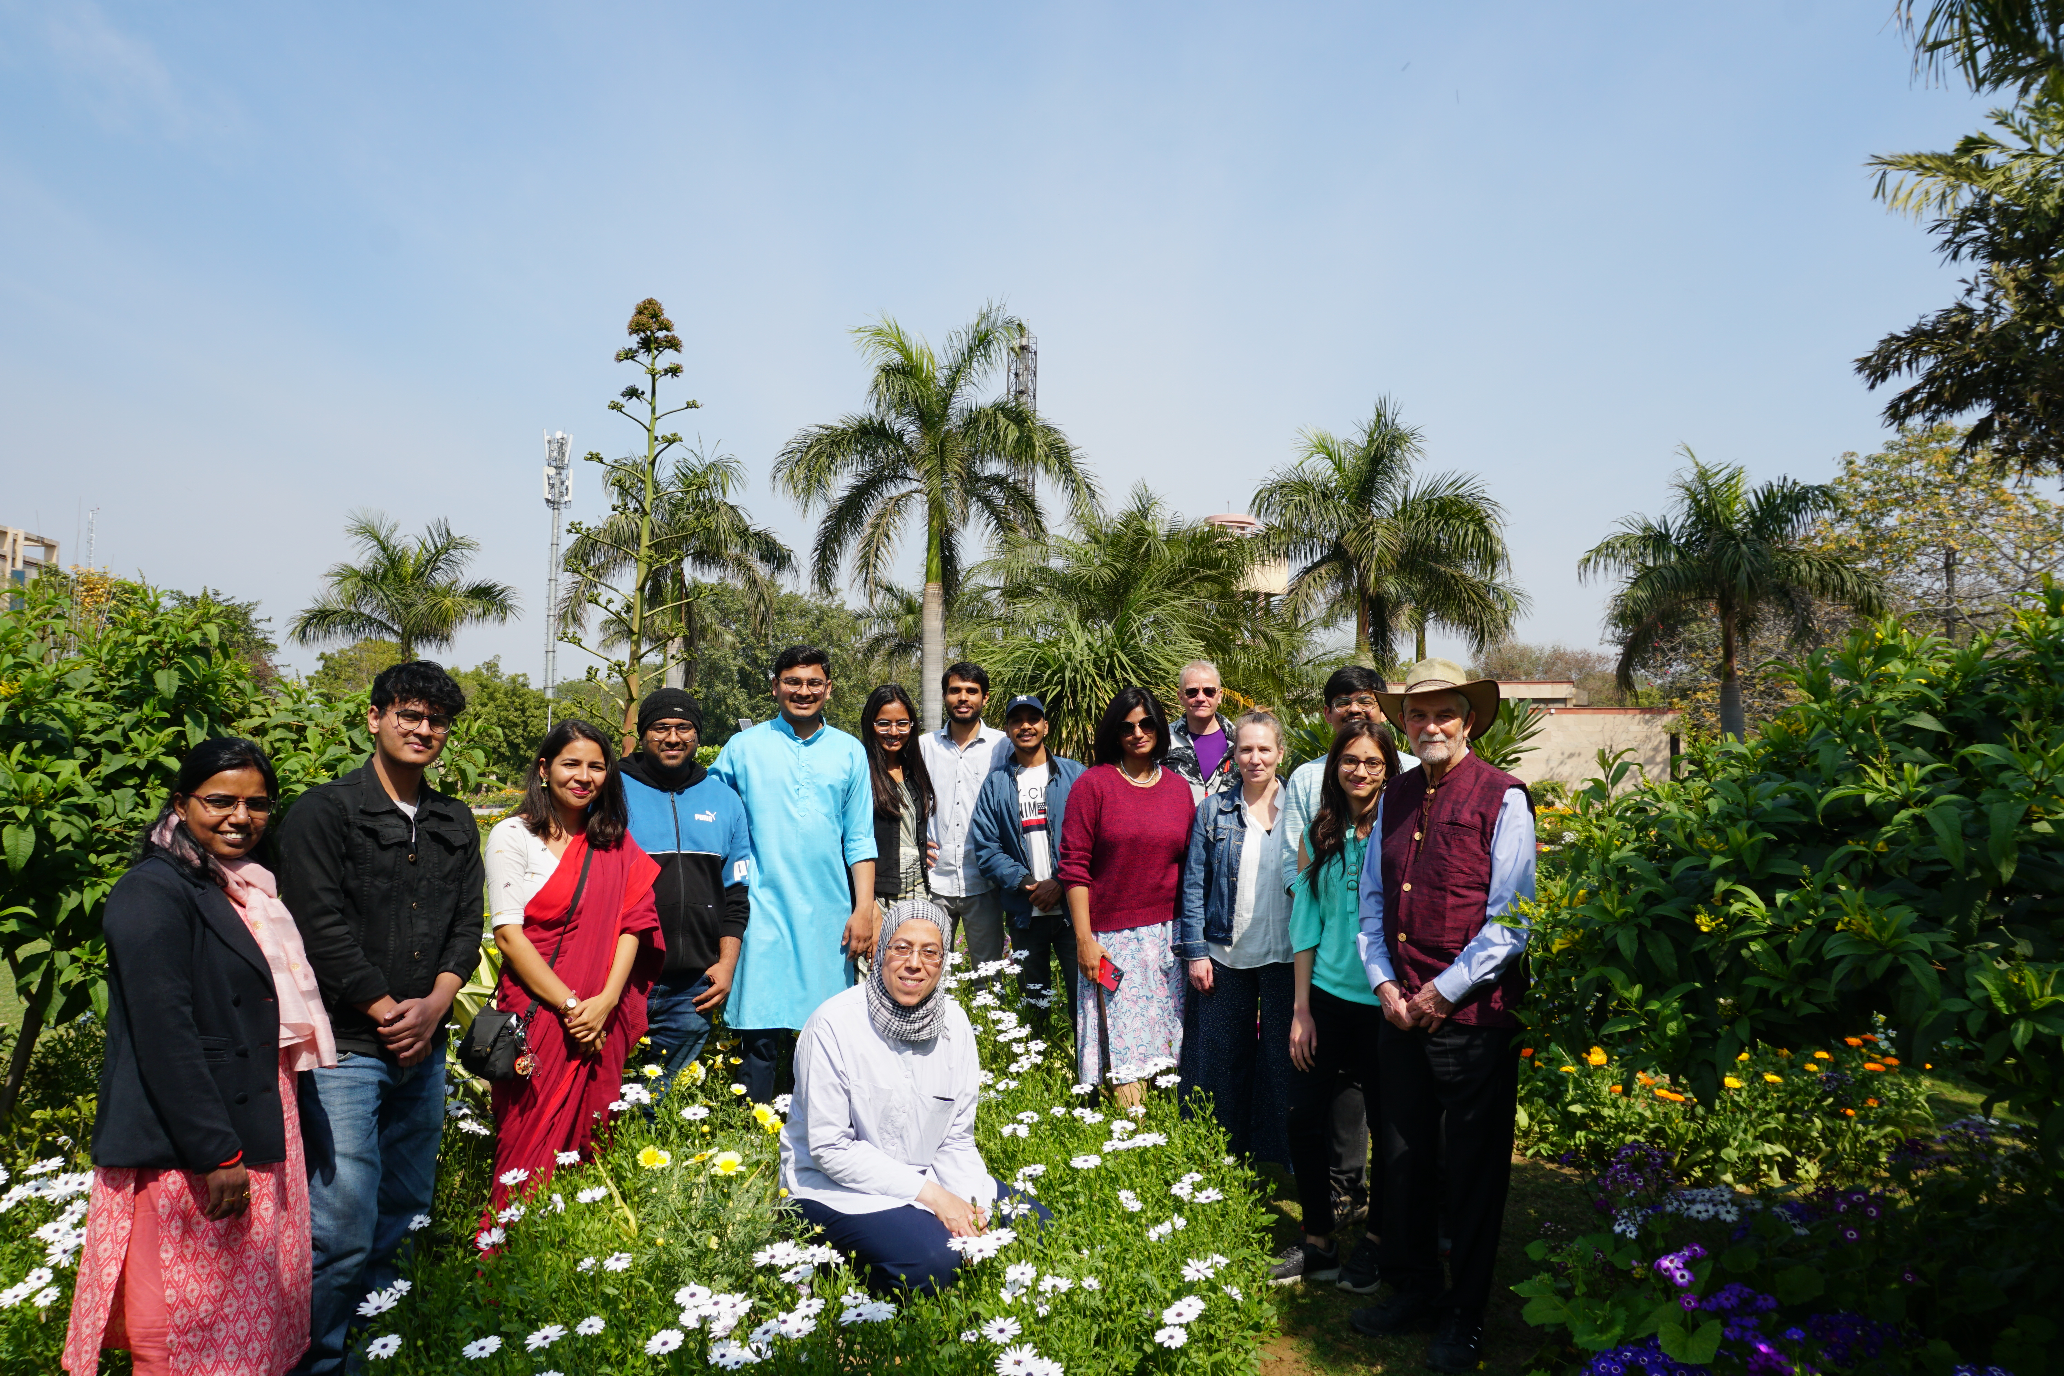
Alumn reunion 2024

Slide 5
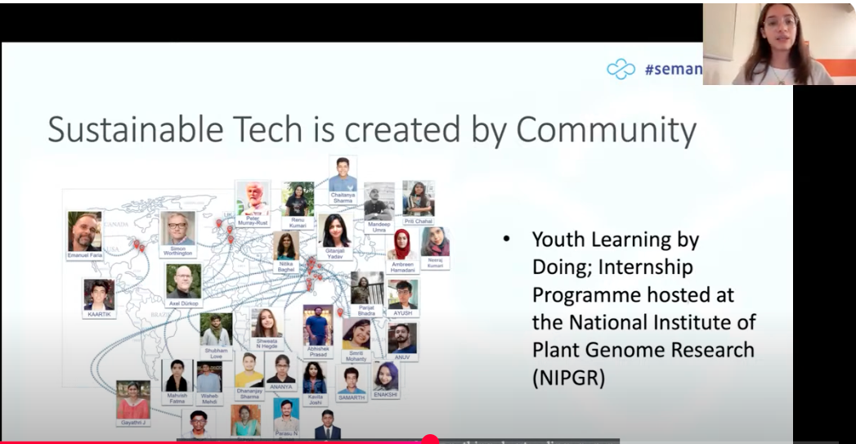
Shweata Hegde
←Ayush Garg
SemanticClimate interns and alumns
Shweata’s talk to OpenKnowledgeFoundation’s TheTechWeWant
https://www.youtube.com/watch?v=o50Jd1w6xKw&t=16843s&ab_channel=OpenKnowledgeFoundation

Slide 6
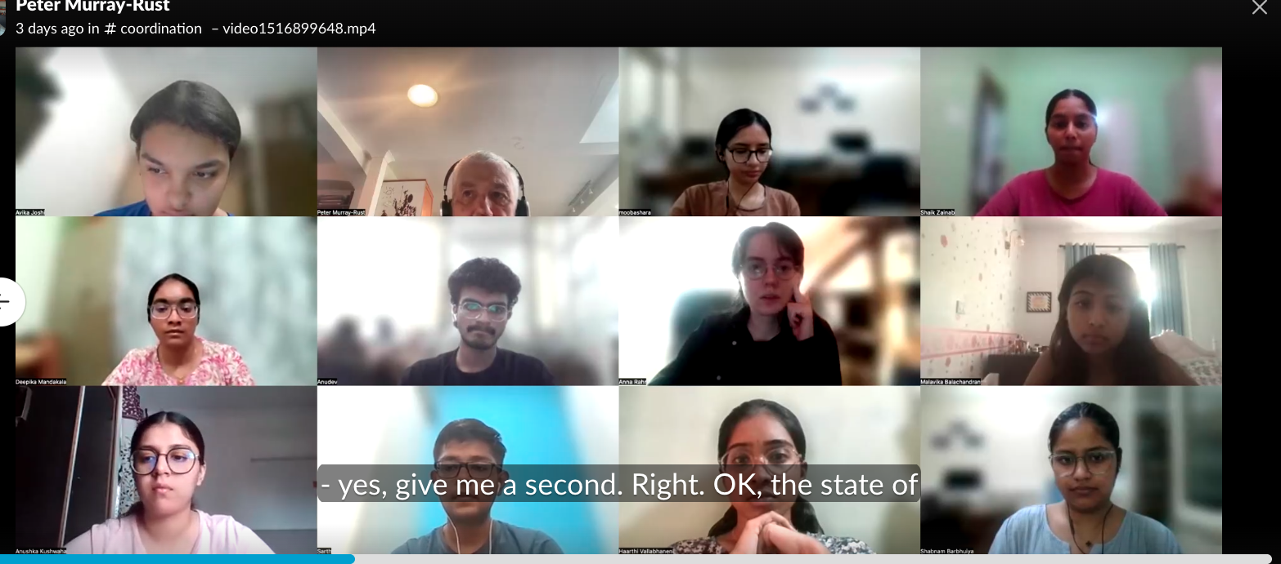
Team meeting Friday 2025-06-06

Slide 7
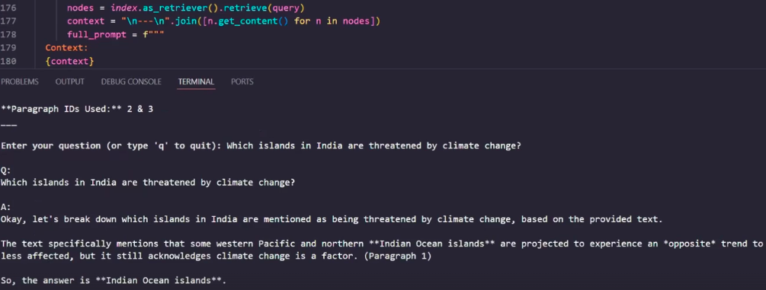
semanticClimate AI: LLM-RAG in action
Anna Rahr, Bachelor’s student, Hannover DE

Slide 8
Thoughts -1
I sent these thoughts before the meeting – they are included for those reading later
We are now in a Polycrisis larger than anyone can understand. In "A Climate of Truth" (Mike Berners-Lee, 2025) lists 7 components of the outer layer. Climate, Energy, Population, Food, Biodiversity, Pollution, Disease. These describe the material world (driven by humans), but we also have the sudden rise of uncontrolled AI , which, even without Artificial General Intelligence (AGI), is an existential threat to our discourse and rationality. I see people automatically offloading their thinking to ChatGPT [1]. As this continues we feed unpredictability, unreliability and irresponsibility into our discourse
The key things are to identify our values and maintain them. As a young person I was heavily influenced by Gandhi's teaching and actions [2], as were/are many other in UK. To his list we could now add in the AI age: * Opinions without thinking
Two values which I want to promote in my talk are Trust and Truth. And I'm struggling with speaking truth to young people on Tuesday because it will be hurtful and might appear arrogant. I asked our interns for feedback about semanticClimate and one replied "I'm really scared". I've talked to a psychiatrist colleague in Cambridgewho tells me that "climate anxiety" is a common medical condition. I don't want to make this worse.
My position so far. As a scientist I believe that the data and the maths of the polycrisis mean that we are inevitably headed for a catastrophe so bad we cannot prevent or imagine it. But others take a less pessimistic view - MikeBL write "What makes me optimistic - Most people want action but don't realise how many others want it too". So I'll take the view that there is hope - but we must all change the way we are working. MikeBL says: ".. a pretty stark picture but we are not definitely doomed" and "everything to play for". on pp222-3 he elaborates on "How should we deal with Climate anxiety?". So I'm taking the view that we *can* do something about the polycrisis - and that allows me to give a constructive talk.

Slide 9
Thoughts - 2
Every generation passes its successes, failures and wisdom to the next (actually 60 years my junior. So my wisdom:
* this applies to late high-schoolers/early college (before the college system has regimented them)are just
* the principles and values that semanticClimate have developed as just as appropriate for AI. In some areas existing AI tools are hugely valuable, but the flip side is that they are largely developed by extractive surveiilance capitalists who will un/consciously build in bias, and unacceptable values. This is especially true for the GlobalSouth - I do not trust California techBros.
* traditional teaching through lectures and books is outdated in the age of AI. For example 3Blue1Brown gives brilliant AI presentations (e.g. https://www.3blue1brown.com/lessons/attention). This is a video of computer animations far beyond what I personally could do. And it would be easy to customise this to individual people by reacting to their input - we already have this with ChatGPT. So what is the role of teachers in the age of AI? At the level of semanticClimate teachers must provide wisdom - what to study, what your values are (I don't believe that AIs have values, though they can pretend or parrot). In semanticClimate we emphasize learning-by-doing on real projects that matter.
* we have to work as a community, as well as individuals. We must communicate everything we do so that we can help others and let others help us.
* Our work is directed towards helping the world solve problems that desperately matter. We cannot solve the polycrisis but we can help with 0.000001 (one millionth) of it. Our role is to gather, transform, enrich and redistribute knowledge that is Trustable.
* Our tools are novel and available to all
* Our operations are self-reproducing. (This is inspired by SoftwareCarpentry and similar initiatives). People learn from our workshops, learn how to run them, how to modify them, and then run them in their own environment (maybe a different demographic). If we are very very fortunate we may create a true meme that spreads everywhere there is receptive ground. This comes through frictionless tools and materials, in non-hierachical communities.
* we must be brave enough to explore the depths and darknesses of the polycrisis. It's very frightening. This requires courage and we need to support each other. And to build ways of working where we can shut out the darkness. It won't go away, and we must speak truth, but working on positive solutions will make it tolerable.
* we will possibly need to Speak Truth To Power, just as Gandhi did to the British and suffered for it. This is the hardest part of this talk. Institutions will react against it. II would be quite wrong for me to tell you what to do or how to do it. In any case it is absolutely critical to support each other.
* Modern tools can flatten demographics. pygetpapers was written by Ayush (15 yr old at school).

Slide 10
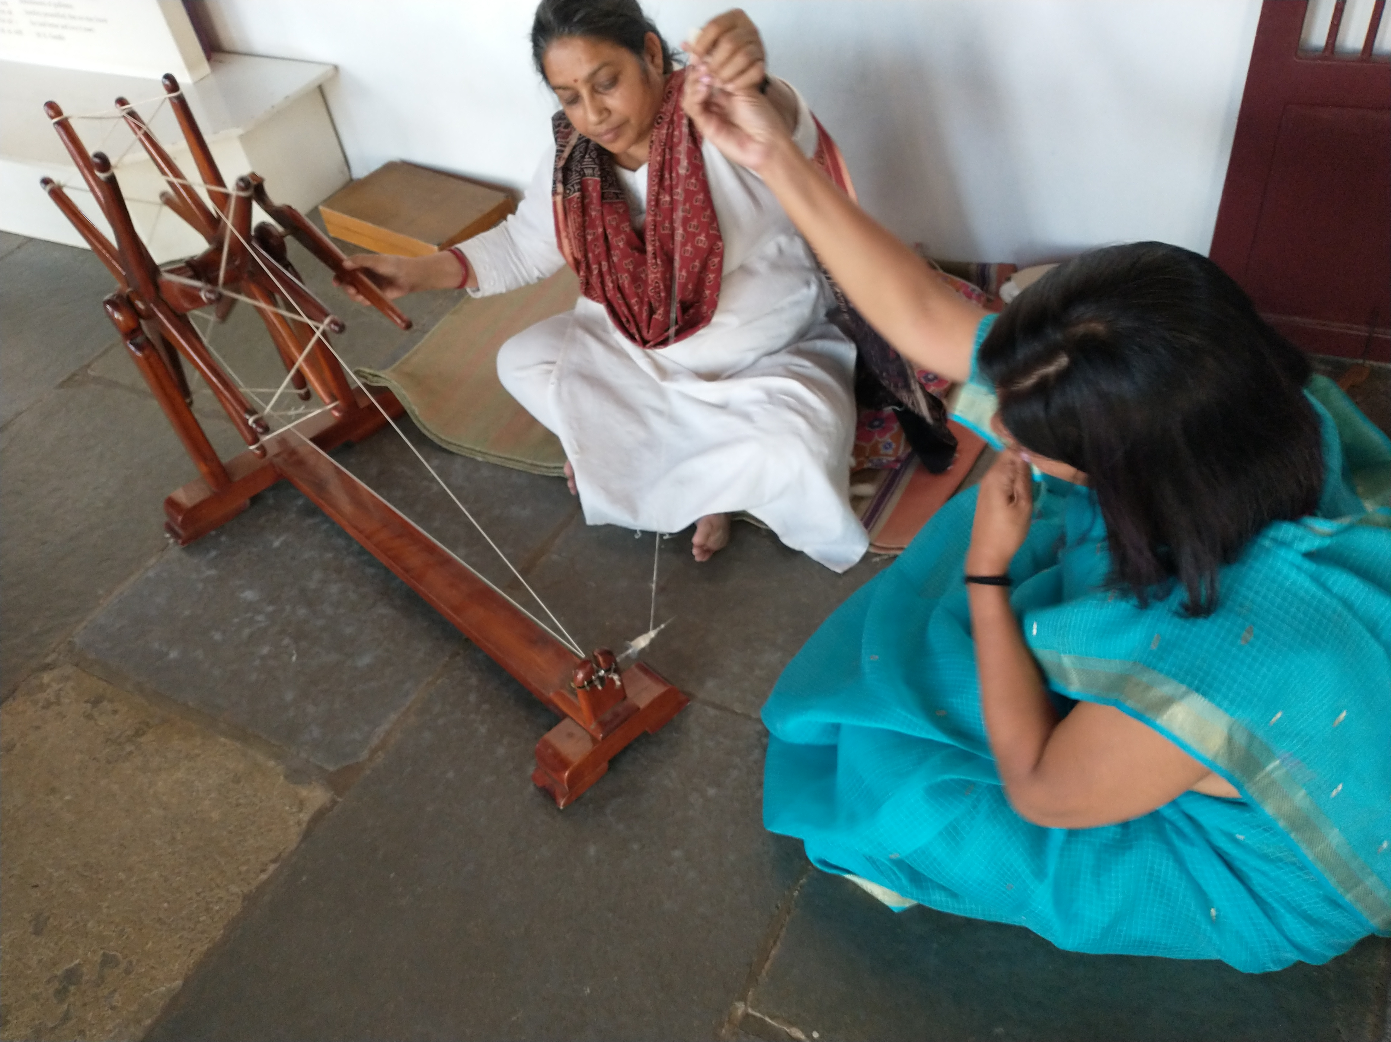
Gita Yadav (seated) At Gandhi’s Ashram 2024,
photo Peter Murray-Rust, CC BY

Slide 11
Additional material follows

Slide 12

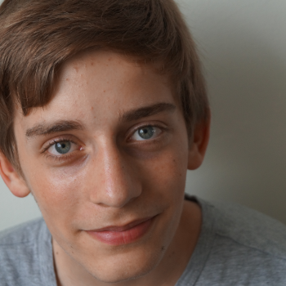
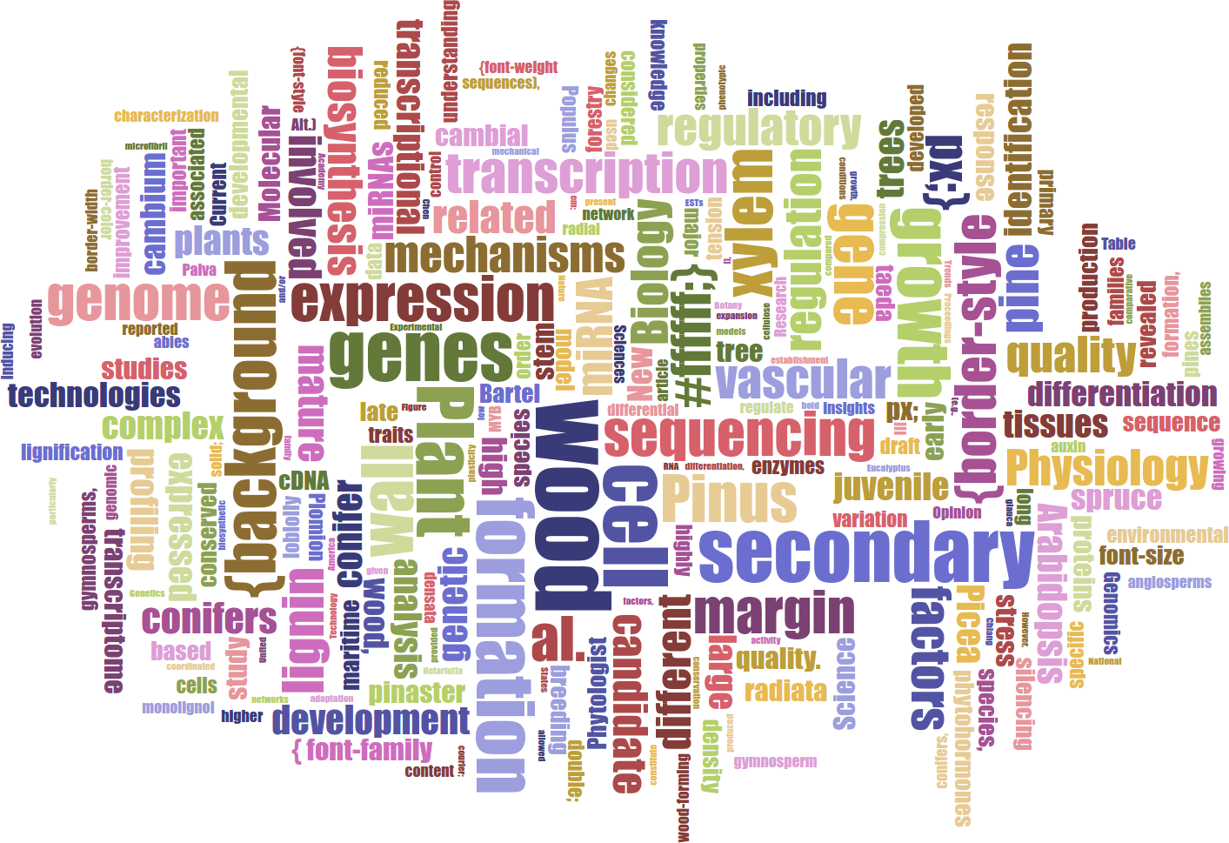
Lars Willighagen
15 years old NL
Wants: extract data about conifers (relations to chemicals, height etc.)
Outcome: database with webpage containing conifer properties
Table Facts Visualiser DEMO
Card DEMO
Word Cloud
„ I applied to this fellowship to learn new things and combine the ContentMine with two previous projects I never got to finish, and I got really excited by the idea and the ContentMine at large.“

Slide 13
The Publisher-Academic complex[1]
$$, MS
review
Taxpayer
$$
$$
Publishers
Academia
Student
Glory+?
in-kind
Infrastructure
Researcher
“The scholarly poor”
[1] The Military-Industrial-Academic complex (1961)
(Dwight D Eisenhower, US President)

Slide 14
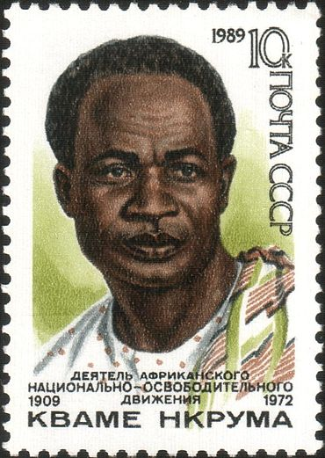
Knowledge Neocolonialism/Capitalism
The result of [knowledge colonialism] is that [corporate] capital is used for the exploitation rather than for the development of the less developed parts of the [knowledge] world.
Investment, under [knowledge imperialism], increases, rather than decreases, the gap between the rich and the poor [scholars] of the world. The struggle against [knowledge neocolonialism] […] is aimed at preventing the financial power of the [megacorporations] being used in such a way as to impoverish the less developed.[5]
(adapted by PMR from Kwame Nkrumah) s/country/scholar/,
s/colonial power/megacorporation/

Slide 15
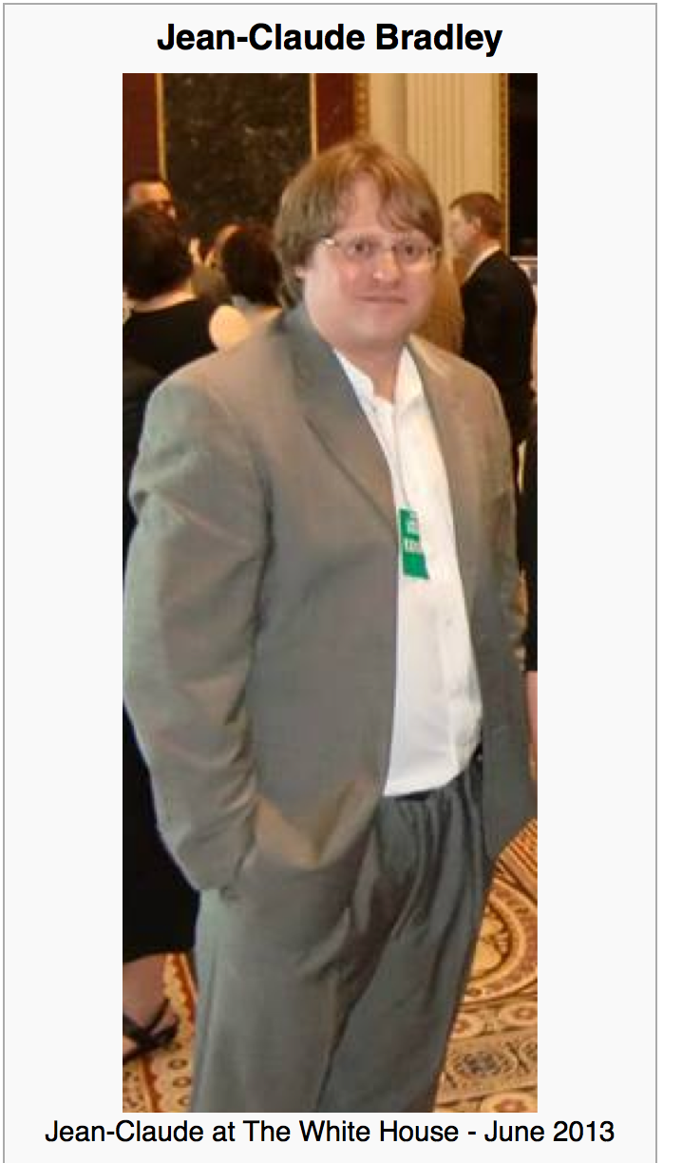

Jean-Claude Bradley
Jean-Claude Bradley was one of the most influential open scientists of our time. He was an innovator in all that he did, from Open Education to bleeding edge Open Science; in 2006, he coined the phrase Open Notebook Science. His loss is felt deeply by friends and colleagues around the world.
On Monday July 14, 2014 we gathered at Cambridge University to honour his memory and the legacy he leaves behind with a highly distinguished set of invited speakers to revisit and build upon the ideas which inspired and defined his life’s work.
Wikipedia CC BY-SA
Notes:
Hi, I’m here to talk about AMI; a data extraction framework and tool. First, I just want highlight some of key contributors to the projects; Andy for his work on the ChemistryVisitor and Peter for the overall architecture.
In this talk, I’m going to impress the importance of data in a specific format and its utility to automated machine processing. Then I’m going to demonstrate AMI’s architecture and the transformation of data as it flows through the process. I’m going to dwell a little on a core format used, Scalable Vector Graphics (SVG) before introducing the concept of visitors, which are pluggable context specific data extractors. Next, I’m going to introduce Andy’s ChemVisitor, for extracting semantic chemistry data, along with a few other visitors that can process non-chemistry specific data. Finally, I will demonstrate some uses of the ChemVisitor, within the realm of validation and metabolism.

Slide 16
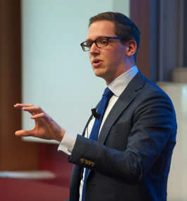
Elsevier stopped me doing my research
Chris Hartgerink
@Senficon (Julia Reda) :Text & Data mining in times of #copyright maximalism:
"Elsevier stopped me doing my research" http://onsnetwork.org/chartgerink/2015/11/16/elsevier-stopped-me-doing-my-research/ … #opencon #TDM

Slide 17
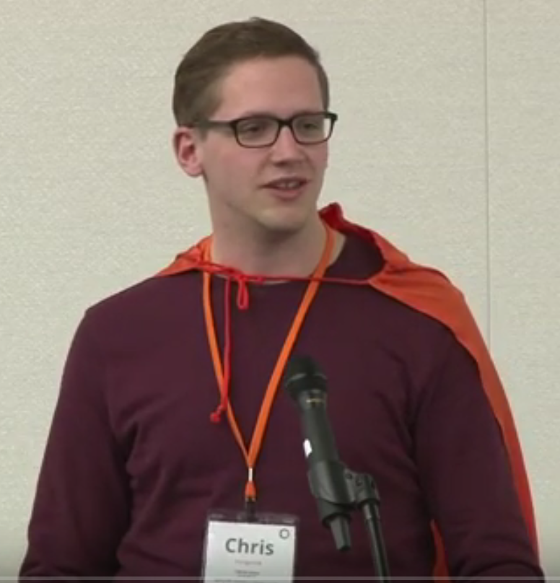
Chris Hartgerink’s blog post
I am a statistician interested in detecting potentially problematic research such as data fabrication, which results in unreliable findings and can harm policy-making, confound funding decisions, and hampers research progress.
To this end, I am content mining results reported in the psychology literature. Content mining the literature is a valuable avenue of investigating research questions with innovative methods. For example, our research group has written an automated program to mine research papers for errors in the reported results and found that 1/8 papers (of 30,000) contains at least one result that could directly influence the substantive conclusion [1].
In new research, I am trying to extract test results, figures, tables, and other information reported in papers throughout the majority of the psychology literature. As such, I need the research papers published in psychology that I can mine for these data. To this end, I started ‘bulk’ downloading research papers from, for instance, Sciencedirect. I was doing this for scholarly purposes and took into account potential server load by limiting the amount of papers I downloaded per minute to 9. I had no intention to redistribute the downloaded materials, had legal access to them because my university pays a subscription, and I only wanted to extract facts from these papers.
Full disclosure, I downloaded approximately 30GB of data from Sciencedirect in approximately 10 days. This boils down to a server load of 0.0021GB/[min], 0.125GB/h, 3GB/day.
Approximately two weeks after I started downloading psychology research papers, Elsevier notified my university that this was a violation of the access contract, that this could be considered stealing of content, and that they wanted it to stop. My librarian explicitly instructed me to stop downloading (which I did immediately), otherwise Elsevier would cut all access to Sciencedirect for my university.
I am now not able to mine a substantial part of the literature, and because of this Elsevier is directly hampering me in my research.
[1] Nuijten, M. B., Hartgerink, C. H. J., van Assen, M. A. L. M., Epskamp, S., & Wicherts, J. M. (2015). The prevalence of statistical reporting errors in psychology (1985–2013). Behavior Research Methods, 1–22. doi: 10.3758/s13428-015-0664-2

Slide 18
Panton Principles for Open Data in science(2010)
PUBLISH YOUR DATA OPENLY
…make an explicit and robust statement of your wishes.
Use a recognized waiver or license that is appropriate for data.
open as defined by the Open Knowledge/Data Definition (… NOT non-commercial)
Explicit dedication of data … into the public domain via PDDL or CCZero
Peter Murray-Rust, Cameron Neylon, Rufus Pollock, John Wilbanks

Slide 19
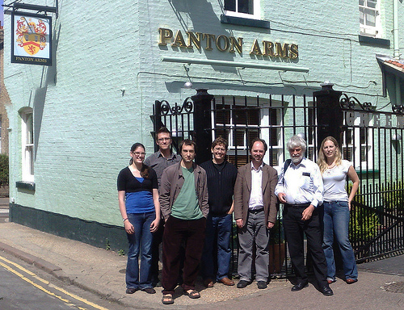
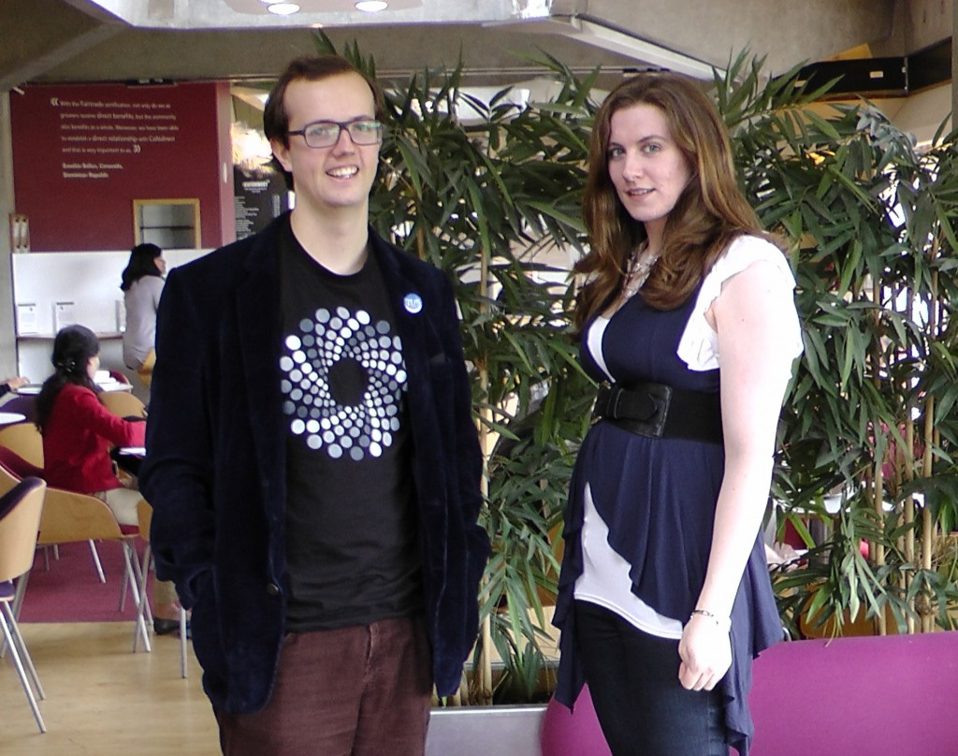
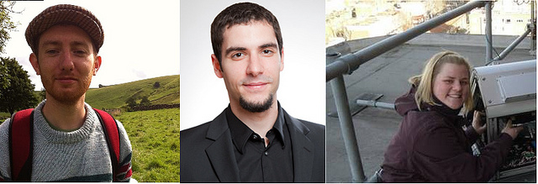
Panton Authors and Fellows

Slide 20
The Hague Declaration on Knowledge Discovery in the Digital Age (2015)
INTELLECTUAL PROPERTY WAS NOT DESIGNED TO REGULATE THE FREE FLOW OF FACTS, DATA AND IDEAS, BUT HAS AS A KEY OBJECTIVE THE PROMOTION OF RESEARCH ACTIVITY
PEOPLE SHOULD HAVE THE FREEDOM TO ANALYSE AND PURSUE INTELLECTUAL CURIOSITY WITHOUT FEAR OF MONITORING OR REPERCUSSIONS
LICENSES AND CONTRACT TERMS SHOULD NOT RESTRICT INDIVIDUALS FROM USING FACTS, DATA AND IDEAS
ETHICS AROUND THE USE OF CONTENT MINING TECHNIQUES WILL NEED TO CONTINUE TO EVOLVE IN RESPONSE TO CHANGING TECHNOLOGY
INNOVATION AND COMMERCIAL RESEARCH BASED ON THE USE OF FACTS, DATA, AND IDEAS SHOULD NOT BE RESTRICTED BY INTELLECTUAL PROPERTY LAW
http://thehaguedeclaration.com/the-hague-declaration-on-knowledge-discovery-in-the-digital-age/
Drafted 2014-12 , convened by LIBER (Association of European Research Libraries)

